Slide 1
[320] Complexity + Big O
Yiyin Shen

Slide 2
Outline
Performance and Complexity
What is a step?
Counting Executed Steps
Big O: for functions/curves
Big O: for algorithms

Slide 3
Performance vs. Complexity
Things that affect performance (total time to run):
????

Slide 4
Performance vs. Complexity
Things that affect performance (total time to run):
speed of the computer (CPU, etc)
speed of Python (quality+efficiency of interpretation)
algorithm: strategy for solving the problem
input size: how much data do we have?

Slide 5
Performance vs. Complexity
Things that affect performance (total time to run):
speed of the computer (CPU, etc)
speed of Python (quality+efficiency of interpretation)
algorithm: strategy for solving the problem
input size: how much data do we have?
complexity analysis: how many steps must the algorithm perform, as a function of input size?

Slide 6
Which algorithm is better?
algorithm B
fewer steps
is faster
algorithm A
Do you prefer A or B?

Slide 7
Which algorithm is better?
algorithm A
fewer steps
is faster
algorithm B
Do you prefer A or B?

Slide 8
Which algorithm is better?
crossover point
algorithm A
fewer steps
is faster
algorithm B

Slide 9
Which algorithm is better?
you might still reasonably care about this portion!
crossover point
algorithm A
fewer steps
is faster
algorithm B
complexity analysis only cares about "big" inputs
What is the asymptotic behavior of the function?

Slide 10
Performance vs. Complexity
Things that affect performance (total time to run):
speed of the computer (CPU, etc)
speed of Python (quality+efficiency of interpretation)
algorithm: strategy for solving the problem
input size: how much data do we have?
what is this?
complexity analysis: how many steps must the algorithm perform, as a function of input size?

Slide 11
Outline
Performance and Complexity
What is a step?
Counting Executed Steps
Big O: for functions/curves
Big O: for algorithms

Slide 12
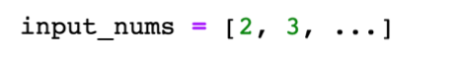
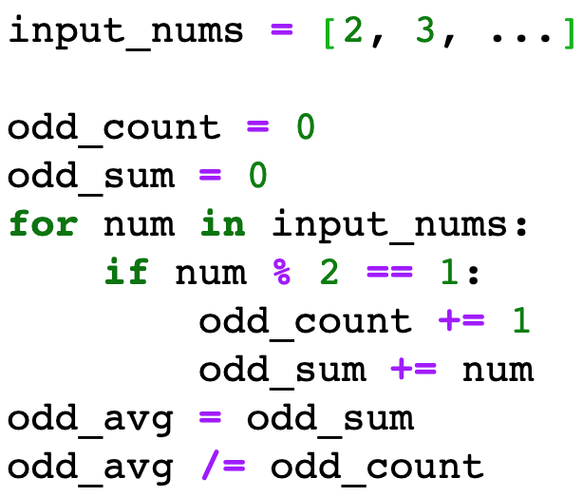
What is a step?
A step is any unit of work with bounded execution time (it doesn't keep getting slower with growing input size)
input size is length of this list
STEP
STEP
STEP
STEP
STEP
STEP
STEP
STEP
Notes:
f22, sec 1

Slide 13
What is a step?
A step is any unit of work with bounded execution time (it doesn't keep getting slower with growing input size)
STEP
STEP
STEP
STEP
also a valid
breakdown
into steps
STEP

Slide 14
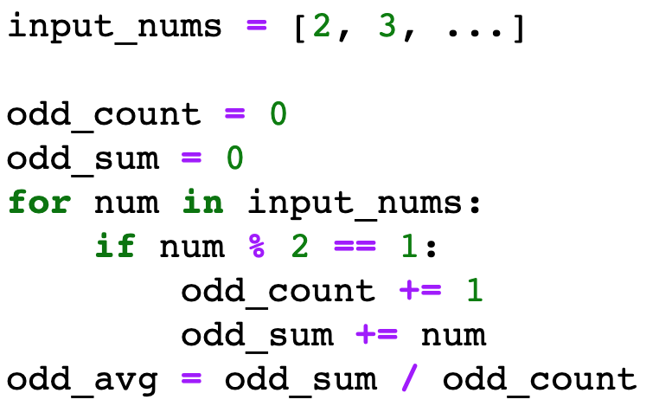
What is a step?
A step is any unit of work with bounded execution time (it doesn't keep getting slower with growing input size)
STEP
STEP
STEP
STEP
STEP
One line can do a lot, so no reason to have lines and steps be equivalent

Slide 15
What is a step?
A step is any unit of work with bounded execution time (it doesn't keep getting slower with growing input size)
STEP
STEP
STEP
STEP
STEP
Sometimes a single line is not a single step:
found = X in L

Slide 16
What is a step?
A step is any unit of work with bounded execution time (it doesn't keep getting slower with growing input size)
STEP
STEP
???
STEP
STEP

Slide 17
What is a step?
"bounded" doesn't mean "fixed"
A step is any unit of work with bounded execution time (it doesn't keep getting slower with growing input size)
STEP
STEP
STEP
STEP

Slide 18
What is a step?
A step is any unit of work with bounded execution time (it doesn't keep getting slower with growing input size)
STEP
???
STEP
(whole loop execution,
not one pass through)
STEP
is this a valid way to identify steps?

Slide 19
What is a step?
A step is any unit of work with bounded execution time (it doesn't keep getting slower with growing input size)
STEP
not a "step", because exec time depends on input size
STEP
(whole loop execution,
not one pass through)
STEP

Slide 20
What is a step?
A step is any unit of work with bounded execution time (it doesn't keep getting slower with growing input size)
STEP
not a "step", because exec time depends on input size
STEP
(whole loop execution,
not one pass through)
STEP
Note! A loop that iterates a bounded number of times (not proportional to input size) COULD be a single step.
Notes:
f22 sec 2

Slide 21
Outline
Performance and Complexity
What is a step?
Counting Executed Steps
Big O: for functions/curves
Big O: for algorithms

Slide 22
Counting Executed Steps
A step is any unit of work with bounded execution time (it doesn't keep getting slower with growing input size)
STEP
STEP
STEP
STEP
How many total steps will execute if len(input_nums) == 10?

Slide 23
Counting Executed Steps
A step is any unit of work with bounded execution time (it doesn't keep getting slower with growing input size)
1
STEP
+ 11
STEP
+ 10
STEP
+ 1
STEP
= 23 steps
For N elements, there will be 2*N+3 steps

Slide 24
Counting Executed Steps
A step is any unit of work with bounded execution time (it doesn't keep getting slower with growing input size)
?
STEP
?
STEP
?
STEP
?
STEP
?
STEP
?
STEP
?
STEP
?
STEP
How many total steps will execute if len(input_nums) == 10?

Slide 25
Counting Executed Steps
A step is any unit of work with bounded execution time (it doesn't keep getting slower with growing input size)
1
STEP
1
STEP
11
STEP
10
STEP
0 to 10
STEP
0 to 10
STEP
1
STEP
1
STEP
How many total steps will execute if len(input_nums) == 10?

Slide 26
Counting Executed Steps
A step is any unit of work with bounded execution time (it doesn't keep getting slower with growing input size)
1
STEP
+ 1
STEP
+ 11
STEP
+ 10
STEP
+ 0 to 10
STEP
+ 0 to 10
STEP
+ 1
STEP
+ 1
STEP
For N elements, there will be between 2*N+5 and 4*N+5 steps

Slide 27
Counting Executed Steps
A step is any unit of work with bounded execution time (it doesn't keep getting slower with growing input size)
1
STEP
+ 1
STEP
+ 11
STEP
+ 10
STEP
+ 0 to 10
STEP
+ 0 to 10
STEP
+ 1
STEP
+ 1
STEP
For N elements, there will be between 2*N+5 and 4*N+5 steps
usually we care about
the worst case

Slide 28
Counting Executed Steps
A step is any unit of work with bounded execution time (it doesn't keep getting slower with growing input size)
2*N+3
OR
4*N+5
answer 1
answer 2
Answer 2 is never bigger than 2 times answer 1.
Answer 1 is never bigger than answer 2.
Important: we might not identify steps the same, but our execution counts can at most differ by a constant factor!
can we broadly
(but rigorously)
categorize based on this?

Slide 29
Outline
Performance and Complexity
What is a step?
Counting Executed Steps
Big O: for functions/curves
Big O: for algorithms
Notes:
s22: LEC 01, 02

Slide 30
How fast?
Documentation
https://scikit-learn.org/stable/modules/linear_model.html#ordinary-least-squares-complexity
https://scikit-learn.org/stable/modules/tree.html#complexity

Slide 31
Big O Notation ("O" is for "order of growth")
Goal: categorize functions (and algorithms) by how fast they grow
do not care about scale
do not care about small inputs
care about shape of the curve
strategy: find some multiple of a general function that is an upper bound
f(N) == 2N² + 100
is an O(N²) function
f(N)

Slide 32
Big O Notation ("O" is for "order of growth")
Goal: categorize functions (and algorithms) by how fast they grow
do not care about scale
do not care about small inputs
care about shape of the curve
strategy: find some multiple of a general function that is an upper bound
f(N) == 2N² + 100
is an O(N²) function
not because N²
is an upper bound

Slide 33
Big O Notation ("O" is for "order of growth")
Goal: categorize functions (and algorithms) by how fast they grow
do not care about scale
do not care about small inputs
care about shape of the curve
strategy: find some multiple of a general function that is an upper bound
crossover
point
f(N) == 2N² + 100
is an O(N²) function
not because N²
is an upper bound
because some multiple is an upper bound after some point

Slide 34
Defining Big O
care about shape of the curve
do not care about small inputs
do not care about scale
If
f(N) ≤ C * g(N)
for large N values and some fixed constant C
Then
f(N) ∈ O(g(N))

Slide 35
Defining Big O
care about shape of the curve
do not care about small inputs
do not care about scale
If
f(N) ≤ C * g(N)
for large N values and some fixed constant C
Then
f(N) ∈ O(g(N))
Sets
...
O(N²)
O(N log N
O(N)
O(log N)
O(1)
O(N!)
f(N)=2*N
Note: if f(N) is in O(N), then of course f(N) is in O(N²) too. When asked, give the most informative answer.

Slide 36
Defining Big O
If
f(N) ≤ C * g(N)
for large N values and some fixed constant C
Then
f(N) ∈ O(g(N))
which ones
are true?
f(N) = 2N ∈ O(N)
f(N) = 100N ∈ O(N²)
f(N) = N² ∈ O(1000000N)

Slide 37
Defining Big O
If
f(N) ≤ C * g(N)
for large N values and some fixed constant C
Then
f(N) ∈ O(g(N))
which ones
are true?
f(N) = 2N ∈ O(N)
f(N) = 100N ∈ O(N²)
f(N) = N² ∈ O(1000000N)

Slide 38
Defining Big O
If
f(N) ≤ C * g(N)
for large N values and some fixed constant C
Then
f(N) ∈ O(g(N))
shortcuts
O(3N⁵ + N⁴ + 8N³ + 3N² + N + 5)
keep leading term
(if finite number)
O(3N⁵)
drop coefficients
O(N⁵)

Slide 39
Outline
Performance and Complexity
What is a step?
Counting Executed Steps
Big O: for functions/curves
Big O: for algorithms

Slide 40
Defining Big O
If
f(N) ≤ C * g(N)
for large N values and some fixed constant C
Then
f(N) ∈ O(g(N))
We'll let f(N) be the number of steps that some
Algorithm A needs to perform for input size N.
When we say Algorithm A ∈ O(g(N)),
we mean that f(N) ∈ O(g(N))

Slide 41
Defining Big O
If
f(N) ≤ C * g(N)
for large N values and some fixed constant C
Then
f(N) ∈ O(g(N))
STEP
2*N+3 ≤ 3 * N
STEP
[for big N values]
STEP
therefore
STEP
this code is O(N)
For N elements, there will be 2*N+3 steps

Slide 42
Defining Big O
If
f(N) ≤ C * g(N)
for large N values and some fixed constant C
Then
f(N) ∈ O(g(N))
STEP
STEP
4*N+5 ≤ 5 * N
STEP
[for big N values]
STEP
STEP
therefore
STEP
STEP
STEP
this code is O(N)
For N elements, there will be between 2*N+5 and 4*N+5 steps

Slide 43
Analysis of Algorithms: Key Ideas
complexity: relationship between input size and steps executed
step: an operation of bounded cost (doesn't scale with input size)
asymptotic analysis: we only care about very large N values for complexity (for example, assume a big list)
worst-case: we'll usually assume the worst arrangement of data because it's harder to do an average case analysis (for example, assume search target at the end of a list)
big O: if f(N) ≤ C * g(N) for large N values and some fixed constant C, big O: then f(N) ∈ O(g(N))

